Slide 1
Chapter 6 Transaction and Concurrency Control
1. Transaction Concepts
2. Transaction Model and State Diagram
3. ACID properties of transaction
4. Serializability- conflict and view serializability
5. SQL Standard Isolation Levels
6. Concurrency Control- Lock-Based Protocols

Slide 2
6.1 Transaction
Transaction is a single logical unit of operation which on collection performs some meaningful actions.
The system should ensure proper execution of transactions
Either the entire transaction executes or none of them executes
The system also manages concurrent execution of transactions
Each transaction access and possible updates various data items.

Slide 3
6.1 Transaction
Let's pick up an example of a simple transaction where a user transfers 620 from A's account into B's account.
This transaction may seem small and straightforward but includes more than a few low-level tasks within it.
The first one is A's Account:
Open_Acct(A)
Old_Bal = A.bal
New_Bal = Old_Bal - 620
A.bal = New_Bal
Close_Acct(A)
The 2nd one is B's transaction:
Open_Acct(B)
Old_Bal = B.bal
New_Bal = Old_Bal + 620
B.bal = New_Bal
Close_Acct(B)

Slide 4
6.1.1 Operation of Transaction
Following are the main operations of transaction:
Read(X): Read operation is used to read the value of X from the database and stores it in a buffer in main memory.
Write(X): Write operation is used to write the value back to the database from the buffer.
Let's take an example to debit transaction from an account which consists of following operations:
1. R(X);
2. X = X - 500;
3. W(X);
Let's assume the value of X before starting of the transaction is 4000.
The first operation reads X's value from database and stores it in a buffer.
The second operation will decrease the value of X by 500. So buffer will contain 3500.
The third operation will write the buffer's value to the database. So X's final value will be 3500.

Slide 5
6.1.1 Operation of Transaction
For example: If in the above transaction, the debit transaction fails after executing operation 2 then X's value will remain 4000 in the database which is not acceptable by the bank.
To solve this problem, we have two important operations:
Commit: It is used to save the work done permanently.
Rollback: It is used to undo the work done.

Slide 6
6.1.2 Transaction model and states
Active state : the transaction is executing in the state
Partially committed: the final statement has been executed.
Committed : the transaction is completely successfully.
Failed: Normal execution can not be proceed.
Aborted: Transaction is rolled back and database is restored

Slide 7
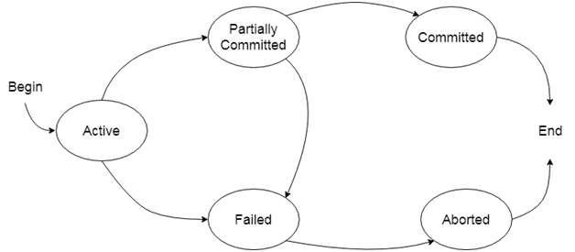
6.1.2 States of Transaction

Slide 8
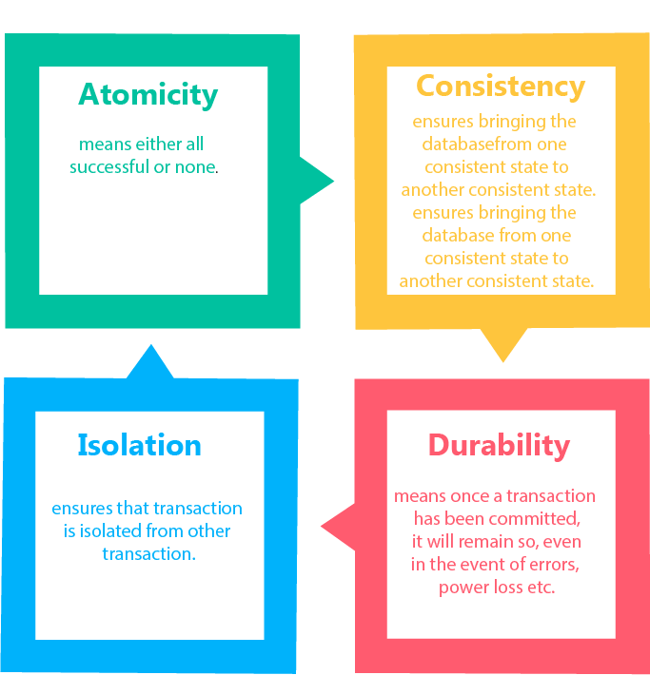
6.2 ACID Properties of Transaction

Slide 9
6.2 ACID Properties of Transaction
Atomicity−
It states that all operations of the transaction take place at once if not, the transaction is aborted.
There is no midway, i.e., the transaction cannot occur partially. Each transaction is treated as one unit and either run to completion or is not executed at all.
Atomicity involves the following two operations:
Abort: If a transaction aborts then all the changes made are not visible.
Commit: If a transaction commits then all the changes made are visible.

Slide 10
6.2 ACID Properties of Transaction
Atomicity−
Example:
T1 | T2
Read(A) A:= A-60 Write(A) | Read(B) Y:= Y+60 Write(B)
After completion of the transaction, A consists of Rs 500 and B consists of Rs 400.
If the transaction T fails after the completion of transaction T1 but before completion of transaction T2, then the amount will be deducted from A but not added to B. This shows the inconsistent database state. In order to ensure correctness of database state, the transaction must be executed in entirety.

Slide 11
6.2 ACID Properties of Transaction
Consistency−
The integrity constraints are maintained so that the database is consistent before and after the transaction.
The execution of a transaction will leave a database in either its prior stable state or a new stable state.
The consistent property of database states that every transaction sees a consistent database instance.
The transaction is used to transform the database from one consistent state to another consistent state.

Slide 12
6.2 ACID Properties of Transaction
Consistency −
Example:
Total before T occurs = 600+300=900
Total after T occurs= 500+400=900
Therefore, the database is consistent. In the case when T1 is completed but T2 fails, then inconsistency will occur.

Slide 13
6.2 ACID Properties of Transaction
Isolation−
It shows that the data which is used at the time of execution of a transaction cannot be used by the second transaction until the first one is completed.
In isolation, if the transaction T1 is being executed and using the data item X, then that data item can't be accessed by any other transaction T2 until the transaction T1 ends.
The concurrency control subsystem of the DBMS enforced the isolation property.

Slide 14
6.2 ACID Properties of Transaction
Durability −
The durability property is used to indicate the performance of the database's consistent state. It states that the transaction made the permanent changes.
They cannot be lost by the erroneous operation of a faulty transaction or by the system failure. When a transaction is completed, then the database reaches a state known as the consistent state. That consistent state cannot be lost, even in the event of a system's failure.
The recovery subsystem of the DBMS has the responsibility of Durability property.

Slide 15
6.3 Schedule
Schedule is the sequence of instructions that specify chronological order in which instructions of concurred transactions are executed.
It must preserve the consistency of the database.
Schedule is a process of lining the transactions and executing them one by one.
When there are multiple transactions that are running in a concurrent manner and the order of operation is needed to be set so that the operations do not overlap each other, Scheduling is brought into play and the transactions are timed accordingly.

Slide 16
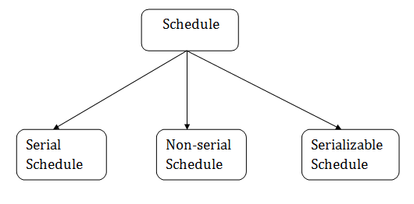
6.3.1 Type of Schedule

Slide 17
6.3.1 Type of Schedule
1. Serial Schedule
Schedules in which the transactions are executed non-interleaved,
i.e., a serial schedule is one in which no transaction starts until a running transaction has ended are called serial schedules.
Always ensure a consistent state.

Slide 18
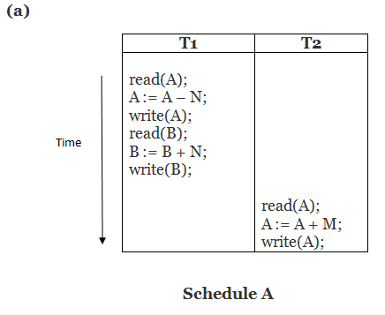
6.3.1 Type of Schedule
1. Serial Schedule
This is a serial schedule since the transactions perform serially in the order T₁ —> T₂

Slide 19
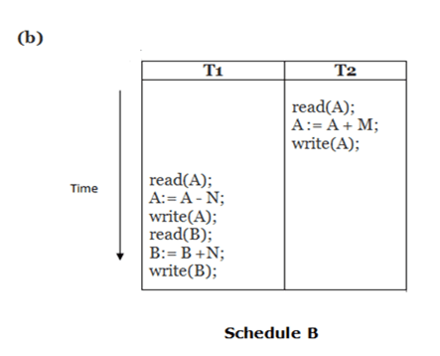
6.3.1 Type of Schedule
1. Serial Schedule
This is a serial schedule since the transactions perform serially in the order T₂ —> T₁

Slide 20
6.3.1 Type of Schedule
2. Non- Serial Schedule
This is a type of Scheduling where the operations of multiple transactions are interleaved.
This might lead to a rise in the concurrency problem.
It contains many possible orders in which the system can execute the individual operations of the transactions.

Slide 21
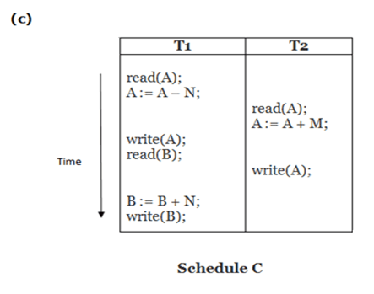
6.3.1 Type of Schedule
2. Non- Serial Schedule

Slide 22
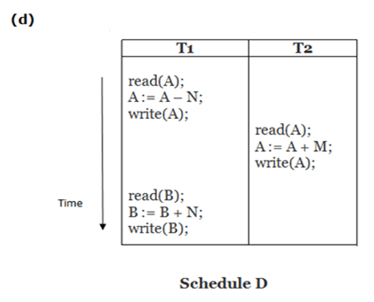
6.3.1 Type of Schedule
2. Non- Serial Schedule

Slide 23
6.3.1 Type of Schedule
3. Serializable schedule
The serializability of schedules is used to find non-serial schedules that allow the transaction to execute concurrently without interfering with one another.
It identifies which schedules are correct when executions of the transaction have interleaving of their operations.
A non-serial schedule will be serializable if its result is equal to the result of its transactions executed serially.

Slide 24
6.3.1 Type of Schedule
Other schedules are :
Recoverable Schedule
Cascading Schedule
Cascadeless Schedule
Strict Schedule
Non - Recoverable Schedule

Slide 25
6.3.1 Type of Schedule
Other schedules are :
a. Recoverable Schedule
Schedules in which transactions commit only after all transactions whose changes they read commit are called recoverable schedules.
In other words, if some transaction Tj is reading value updated or written by some other transaction Ti, then the commit of Tj must occur after the commit of Ti.

Slide 26
6.3.1 Type of Schedule
Other schedules are :
a. Recoverable Schedule
T₁ | T₂
R(A)
W(A)
 | W(A)
 | R(A)
commit
 | commit
This is a recoverable schedule since T₁ commits before T₂, that makes the value read by T₂ correct.

Slide 27
6.3.1 Type of Schedule
Other schedules are :
b. Cascading Schedule
Also called Avoids cascading aborts/rollbacks (ACA).
When there is a failure in one transaction and this leads to the rolling back or aborting other dependent transactions, then such scheduling is referred to as Cascading rollback or cascading abort.

Slide 28
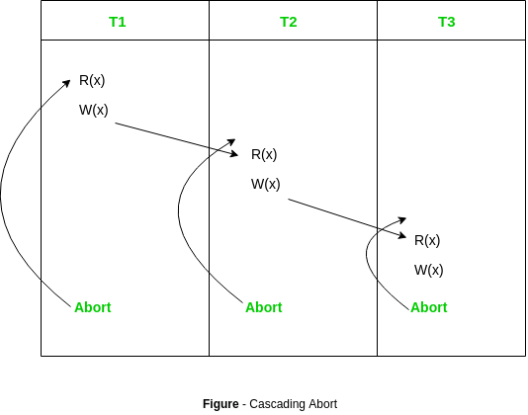
6.3.1 Type of Schedule
Other schedules are :
b. Cascading Schedule

Slide 29
6.3.1 Type of Schedule
Other schedules are :
c. Cascadeless Schedule
Schedules in which transactions read values only after all transactions whose changes they are going to read commit are called cascadeless schedules.
Avoids that a single transaction abort leads to a series of transaction rollbacks.
In other words, if some transaction Tj wants to read value updated or written by some other transaction Ti, then the commit of Tj must read it after the commit of Ti.

Slide 30
6.3.1 Type of Schedule
Other schedules are :
c. Cascadeless Schedule
T1 | T2
R(A)
W(A)
 | W(A)
commit
 | R(A)
 | commit
This schedule is cascadeless. Since the updated value of A is read by T₂ only after the updating transaction i.e. T₁ commits.

Slide 31
6.3.1 Type of Schedule
Other schedules are :
d. Strict Schedule
A schedule is strict if for any two transactions Ti, Tj, if a write operation of Ti precedes a conflicting operation of Tj (either read or write), then the commit or abort event of Ti also precedes that conflicting operation of Tj.
In other words, Tj can read or write updated or written value of Ti only after Ti commits/aborts.

Slide 32
6.3.1 Type of Schedule
Other schedules are :
d. Strict Schedule
T₁ | T₂
R(A)
 | R(A)
W(A)
commit
 | W(A)
 | R(A)
 | commit
This is a strict schedule since T₂ reads and writes A which is written by T₁ only after the commit of T₁.

Slide 33
6.3.1 Type of Schedule
Other schedules are :
e. Non - Recoverable Schedule
T1 T2
R(A)
W(A)
W(A)
R(A)
commit
abort
T₂ read the value of A written by T₁, and committed. T₁ later aborted, therefore the value read by T₂ is wrong, but since T₂ committed, this schedule is non-recoverable.

Slide 34
6.4 Serializability
A schedule is serial if for every transaction participating in the schedule , all operations of a transaction executed consecutively in the schedule
A schedule is serializable if it is not serial but is equivalent to some serial schedule of same transactions
Two schedules are result equivalent if they produce the same final state of the database

Slide 35
6.4.1 Types of Serializability
Conflict Serializability
View Serializability

Slide 36
6.4.1.1 Conflict Serializability
A schedule is called conflict serializability if after swapping of non-conflicting operations, it can transform into a serial schedule.
The schedule will be a conflict serializable if it is conflict equivalent to a serial schedule.

Slide 37
6.4.1.1 Conflict Serializability
Conflicting Operations
The two operations become conflicting if all conditions satisfy:
Both belong to separate transactions.
They have the same data item.
They contain at least one write operation.
Note: Conflict pairs for the same data item are:
Read-Write
Write-Write
Write-Read

Slide 38
6.4.1.1 Conflict Serializability
Test for conflict serializability
Swapping Method
Precedence graph method

Slide 39
6.4.1.1 Conflict Serializability
Test for conflict serializability : Swapping Method
Two schedules are called as a conflict equivalent schedule if one schedule can be transformed into another schedule by swapping non-conflicting operations.

Slide 40
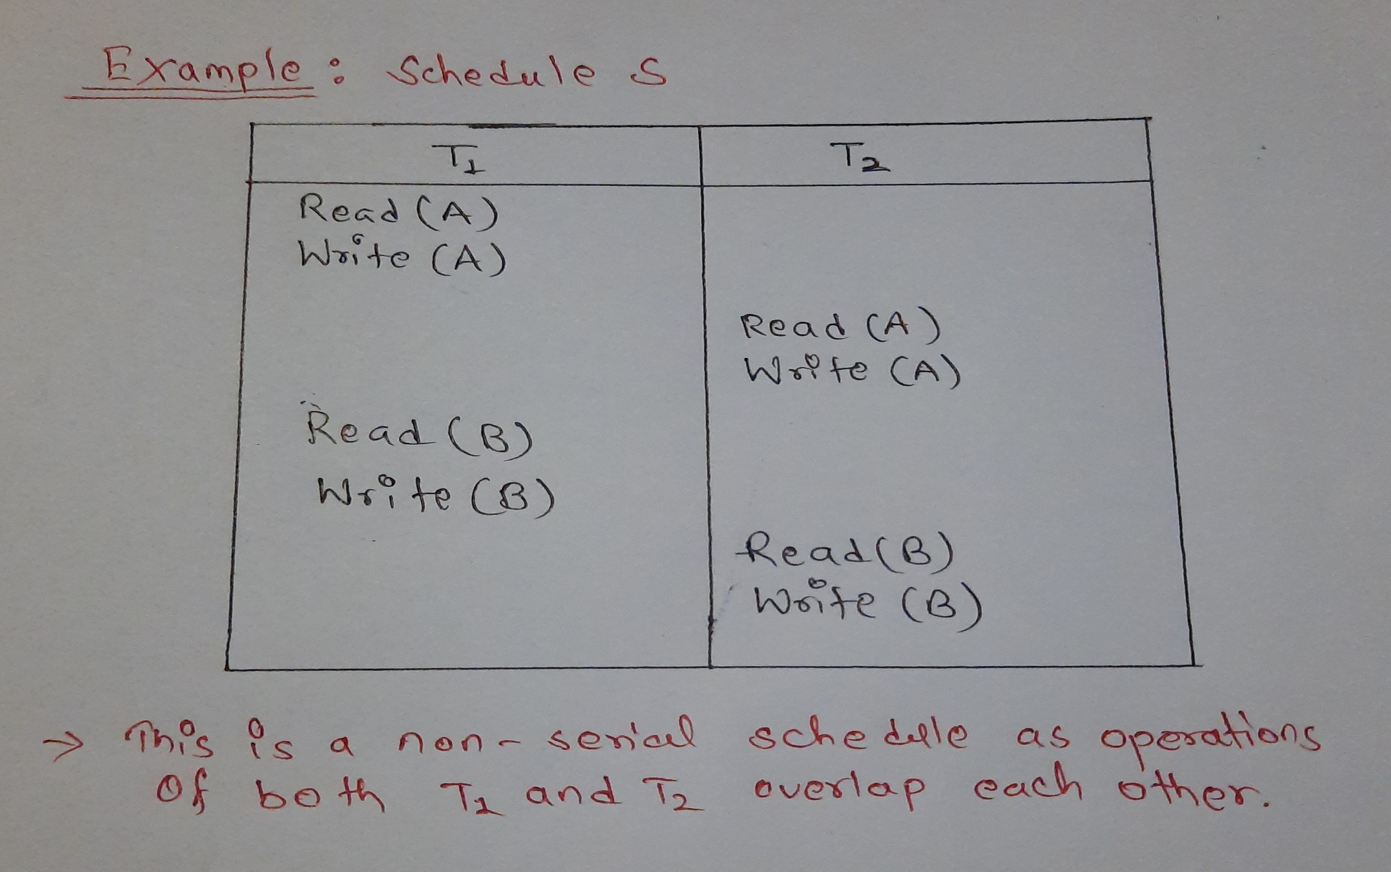
6.4.1.1 Conflict Serializability
Test for conflict serializability : Swapping Method

Slide 41
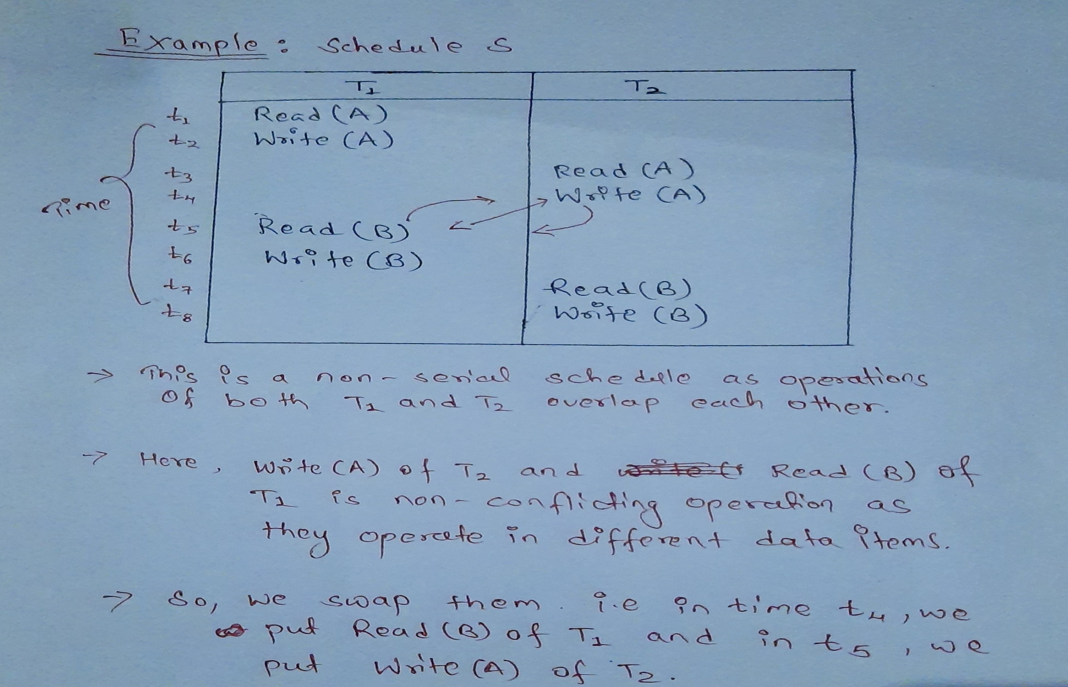
6.4.1.1 Conflict Serializability
Test for conflict serializability : Swapping Method

Slide 42
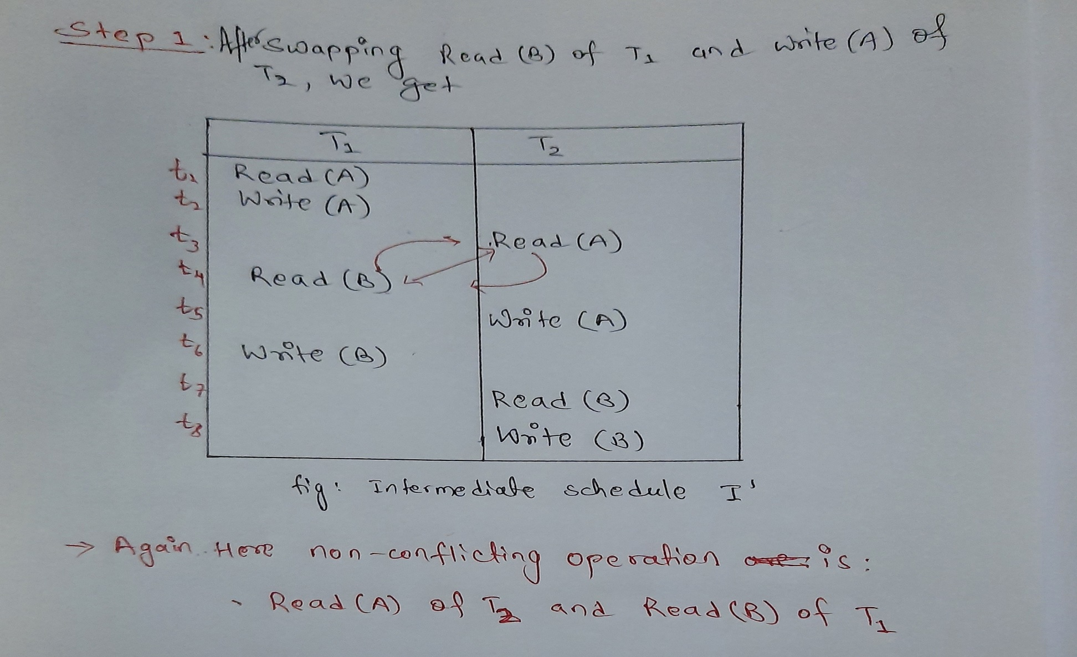
6.4.1.1 Conflict Serializability
Test for conflict serializability : Swapping Method

Slide 43
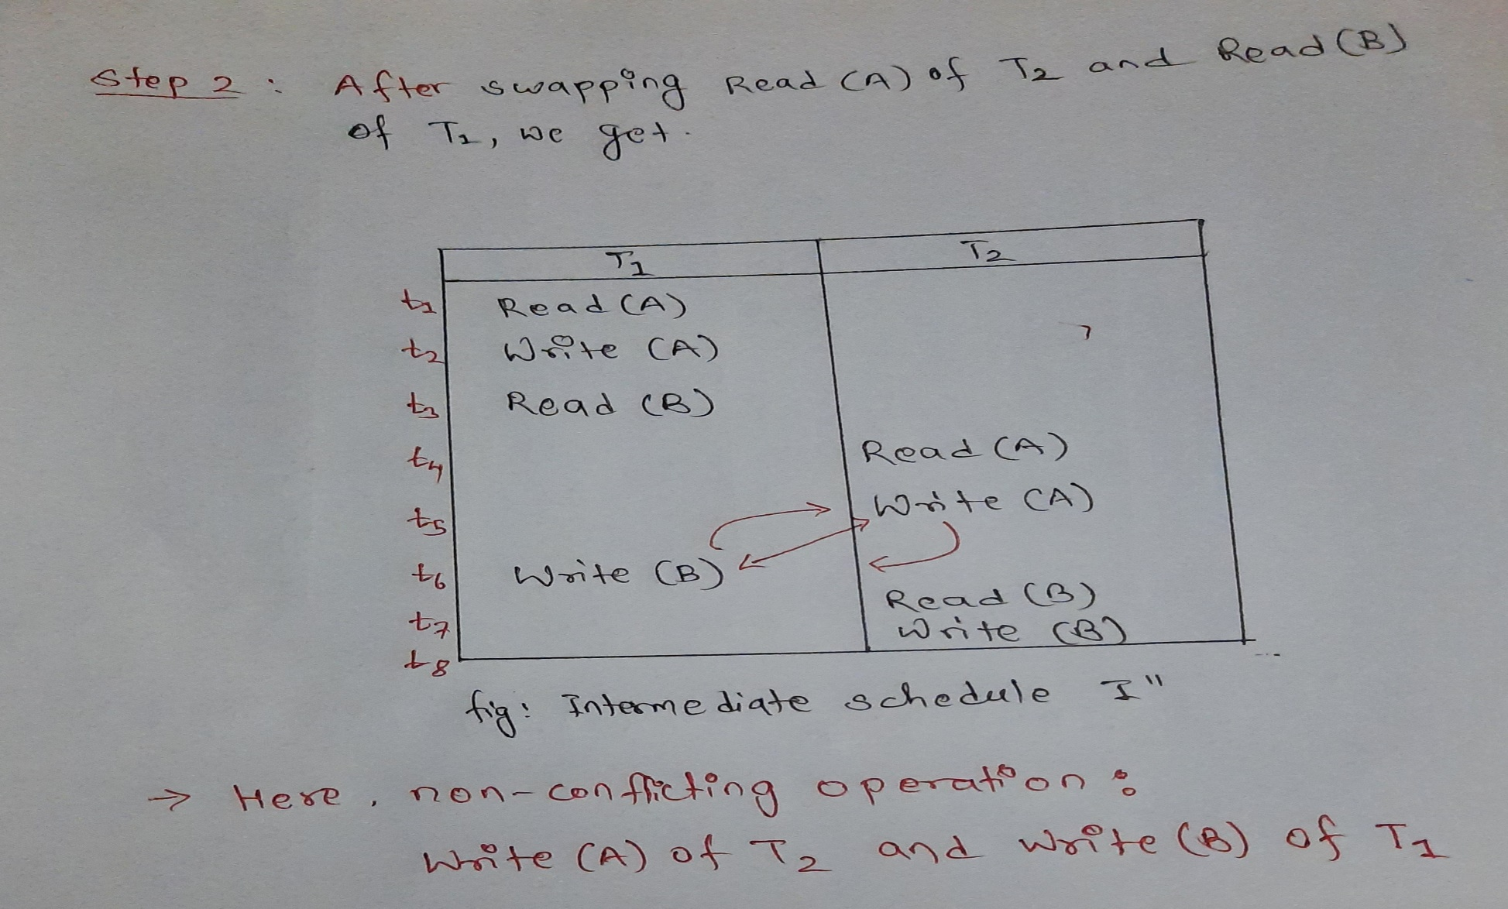
6.4.1.1 Conflict Serializability
Test for conflict serializability : Swapping Method

Slide 44
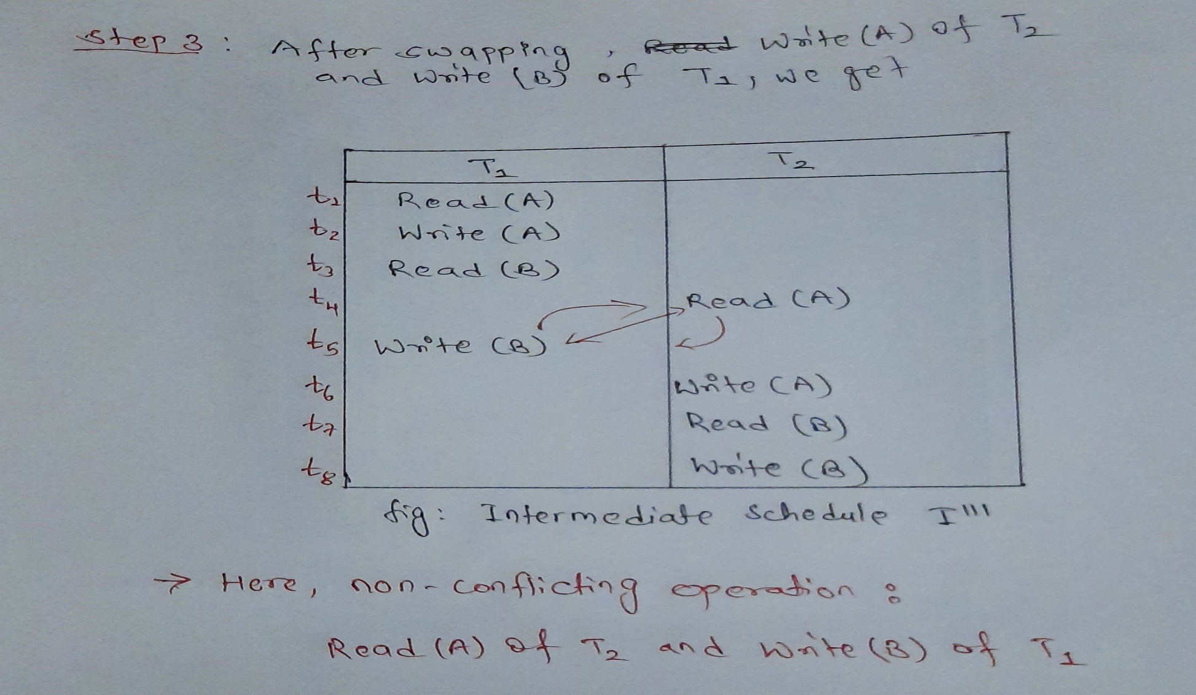
6.4.1.1 Conflict Serializability
Test for conflict serializability : Swapping Method

Slide 45
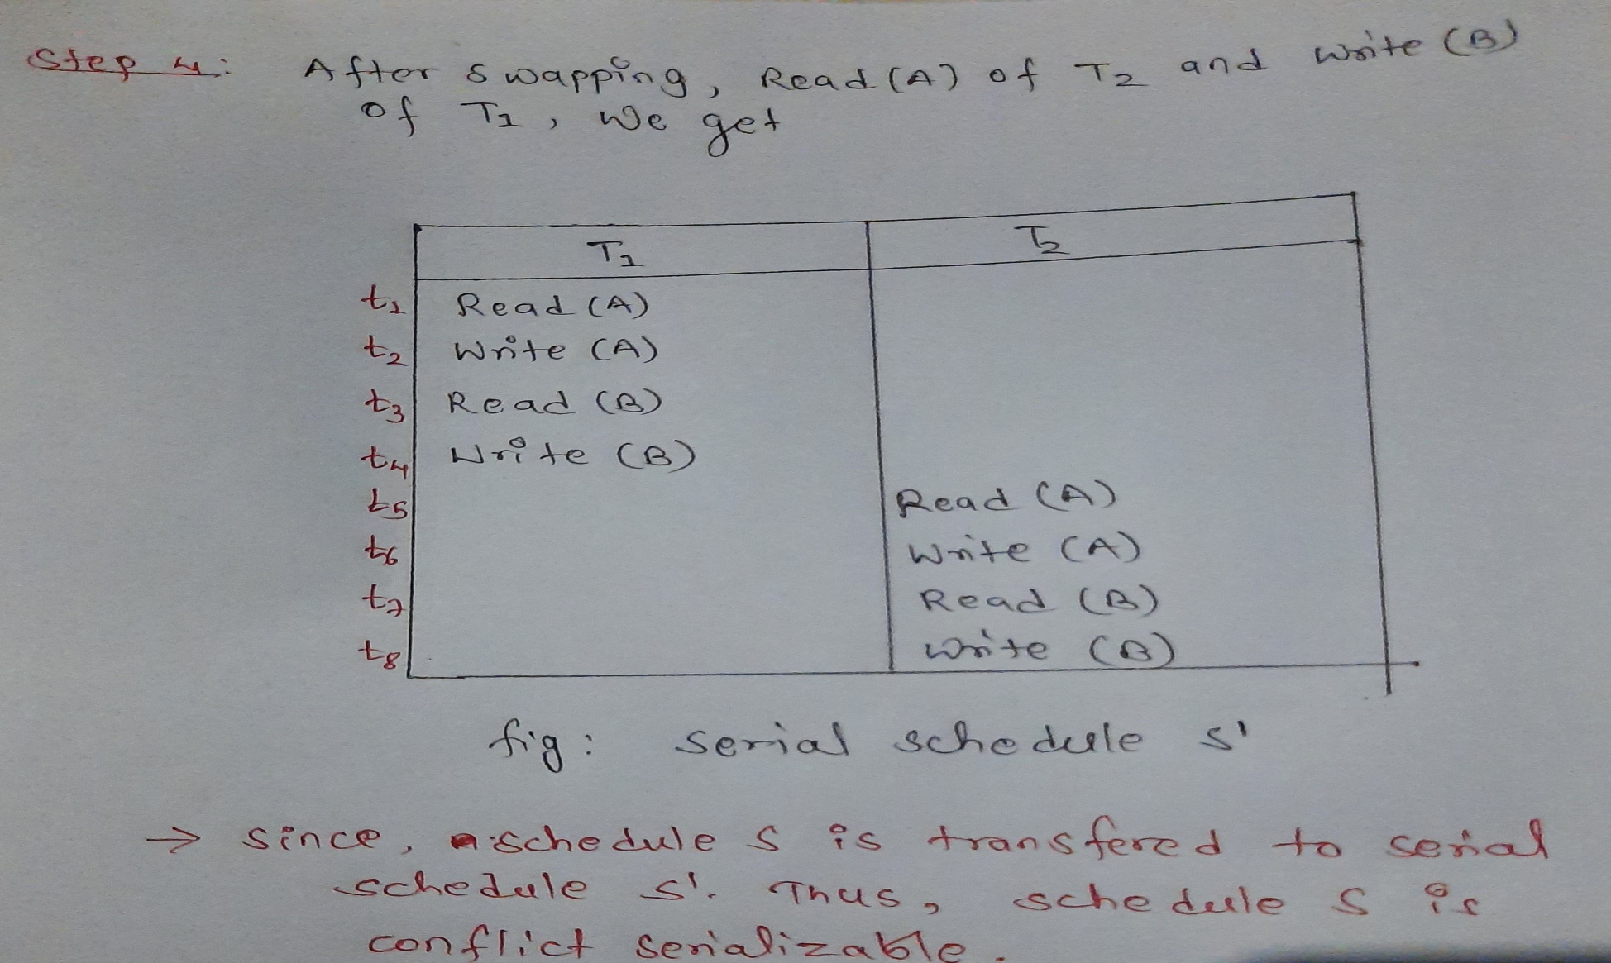
6.4.1.1 Conflict Serializability
Test for conflict serializability : Swapping Method

Slide 46
6.4.1.1 Conflict Serializability
Test for conflict serializability : Precedence graph method
Precedence Graph or Serialization Graph is used commonly to test Conflict Serializability of a schedule.
It is a directed Graph (V, E) consisting of a set of nodes V = {T1, T2, T3……….Tn} and a set of directed edges E = {e1, e2, e3………………em}.

Slide 47
6.4.1.1 Conflict Serializability
Test for conflict serializability : Precedence graph method
The Algorithm can be written as:
Create a node T in the graph for each participating transaction in the schedule.
For the conflicting operation read_item(X) and write_item(X) – If a Transaction Tj executes a read_item (X) after Ti executes a write_item (X), draw an edge from Ti to Tj in the graph.
For the conflicting operation write_item(X) and read_item(X) – If a Transaction Tj executes a write_item (X) after Ti executes a read_item (X), draw an edge from Ti to Tj in the graph.
For the conflicting operation write_item(X) and write_item(X) – If a Transaction Tj executes a write_item (X) after Ti executes a write_item (X), draw an edge from Ti to Tj in the graph.
The Schedule S is serializable if there is no cycle in the precedence graph.
Note : If there is no cycle in the precedence graph, it means we can construct a serial schedule S’ which is conflict equivalent to the schedule S.

Slide 48
6.4.1.1 Conflict Serializability
Test for conflict serializability : Precedence graph method
Example :Schedule S2 (Non-Serial Schedule):
Time | Transaction T1 | Transaction T2 | Transaction T3
t1 | Read(X)
t2 |  |  | Read(Y)
t3 |  |  | Read(X)
t4 |  | Read(Y)
t5 |  | Read(Z)
t6 |  |  | Write(Y)
t7 |  | Write(Z)
t6 | Read(Z)
t9 | Write(X)
t6 | Write(Z)

Slide 49
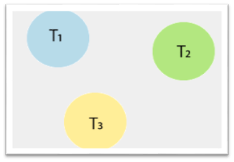
6.4.1.1 Conflict Serializability
Test for conflict serializability : Precedence graph method
Precedence graph for schedule S2:
In the above schedule, there are three transactions: T1, T2, and T3. So, the precedence graph contains three vertices.

Slide 50
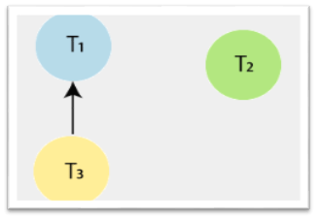
6.4.1.1 Conflict Serializability
Test for conflict serializability : Precedence graph method
To draw the edges between these nodes or vertices, follow the below steps:
Step1: At time t1, there is no conflicting operation for read(X) of Transaction T1.
Step2: At time t2, there is no conflicting operation for read(Y) of Transaction T3.
Step3: At time t3, there exists a conflicting operation Write(X) in transaction T1 for read(X) of Transaction T3. So, draw an edge from T3 →T1.

Slide 51
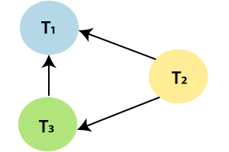
6.4.1.1 Conflict Serializability
Test for conflict serializability : Precedence graph method
To draw the edges between these nodes or vertices, follow the below steps:
Step4: At time t4, there exists a conflicting operation Write(Y) in transaction T3 for read(Y) of Transaction T2. So, draw an edge from T2→T3.
Step5: At time t5, there exists a conflicting operation Write (Z) in transaction T1 for read (Z) of Transaction T2. So, draw an edge from T2→T1.

Slide 52
6.4.1.1 Conflict Serializability
Test for conflict serializability : Precedence graph method
To draw the edges between these nodes or vertices, follow the below steps:
Step6: At time t6, there is no conflicting operation for Write(Y) of Transaction T3.
Step7: At time t7, there exists a conflicting operation Write (Z) in transaction T1 for Write (Z) of Transaction T2. So, draw an edge from T2→T1, but it is already drawn.

Slide 53
6.4.1.1 Conflict Serializability
Test for conflict serializability : Precedence graph method
After all the steps, the precedence graph will be ready, and it does not contain any cycle or loop, so the above schedule S2 is conflict serializable.
And it is equivalent to a serial schedule.

Slide 54
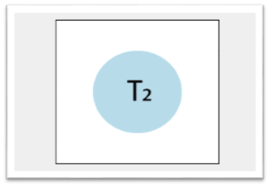
6.4.1.1 Conflict Serializability
Test for conflict serializability : Precedence graph method
Above given schedule S2 is transformed into the serial schedule by using the following steps:
Step1: Check the vertex in the precedence graph where indegree=0. So, take the vertex T2 from the graph and remove it from the graph.

Slide 55
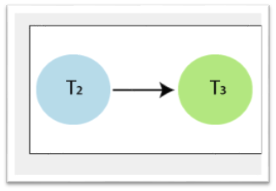
6.4.1.1 Conflict Serializability
Test for conflict serializability : Precedence graph method
Above given schedule S2 is transformed into the serial schedule by using the following steps:
Step 2: Again check the vertex in the left precedence graph where indegree=0. So, take the vertex T3 from the graph and remove it from the graph. And draw the edge from T2→T3.

Slide 56
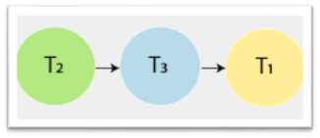
6.4.1.1 Conflict Serializability
Test for conflict serializability : Precedence graph method
Above given schedule S2 is transformed into the serial schedule by using the following steps:
Step3: And at last, take the vertex T1 and connect with T3.
This is the Precedence graph equivalent to schedule S2

Slide 57
6.4.1.1 Conflict Serializability
Test for conflict serializability : Precedence graph method
So , final serial Schedule equivalent to non – serial schedule S2 is given below:
Time | Transaction T1 | Transaction T2 | Transaction T3
t1 |  | Read(Y)
t2 |  | Read(Z)
t3 |  | Write(Z)
t4 |  |  | Read(Y)
t5 |  |  | Read(X)
t6 |  |  | Write(Y)
t7 | Read(X)
t6 | Read(Z)
t9 | Write(X)
t6 | Write(Z)

Slide 58
6.4.1.2 View Serializability
A schedule will view serializable if it is view equivalent to a serial schedule.
If a schedule is conflict serializable, then it will be view serializable.

Slide 59
6.4.1.2 View Serializability
View Equivalent
Two schedules S1 and S2 are said to be view equivalent if they satisfy the following conditions:
1. Initial Read
2. Update Read
3. Final Write

Slide 60
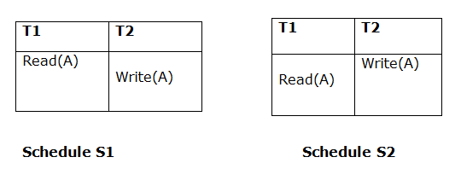
6.4.1.2 View Serializability
View Equivalent
1. Initial Read :
An initial read of both schedules must be the same. Suppose two schedule S1 and S2. In schedule S1, if a transaction T1 is reading the data item A, then in S2, transaction T1 should also read A.
Above two schedules are view equivalent because Initial read operation in S1 is done by T1 and in S2 it is also done by T1.

Slide 61
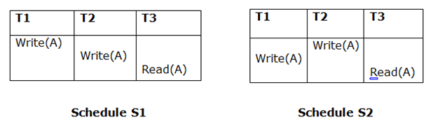
6.4.1.2 View Serializability
View Equivalent
2. Update Read :
In schedule S1, if Ti is reading A which is updated by Tj then in S2 also, Ti should read A which is updated by Tj.
Above two schedules are not view equal because, in S1, T3 is reading A updated by T2 and in S2, T3 is reading A updated by T1.

Slide 62
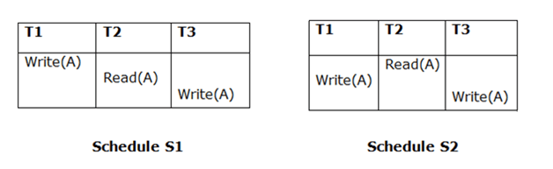
6.4.1.2 View Serializability
View Equivalent
3. Final Write:
A final write must be the same between both the schedules. In schedule S1, if a transaction T1 updates A at last then in S2, final writes operations should also be done by T1.
Above two schedules is view equal because Final write operation in S1 is done by T3 and in S2, the final write operation is also done by T3.

Slide 63
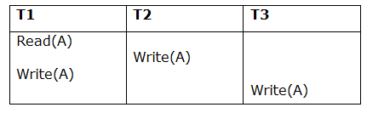
6.4.1.2 View Serializability
Example
Schedule S

Slide 64
6.4.1.2 View Serializability
With 3 transactions, the total number of possible schedule = 3! = 6
S1 = <T1 T2 T3>
S2 = <T1 T3 T2>
S3 = <T2 T3 T1>
S4 = <T2 T1 T3>
S5 = <T3 T1 T2>
S6 = <T3 T2 T1>

Slide 65
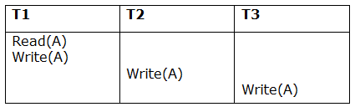
6.4.1.2 View Serializability
Taking first schedule S1:
Schedule S1

Slide 66
6.4.1.2 View Serializability
Step 1: final updation on data items
In both schedules S and S1, there is no read except the initial read that's why we don't need to check that condition.
Step 2: Initial Read
The initial read operation in S is done by T1 and in S1, it is also done by T1.
Step 3: Final Write
The final write operation in S is done by T3 and in S1, it is also done by T3. So, S and S1 are view Equivalent.
The first schedule S1 satisfies all three conditions, so we don't need to check another schedule.
Hence, view equivalent serial schedule is:
T1 → T2 → T3

Slide 67
6.5 Concurrency Control
Concurrency Control is the management procedure that is required for controlling concurrent execution of the operations that take place on a database.
But before knowing about concurrency control, we should know about concurrent execution.

Slide 68
6.5.1 Concurrent Execution
In a multi-user system, multiple users can access and use the same database at one time, which is known as the concurrent execution of the database.
The thing is that the simultaneous execution that is performed should be done in an interleaved manner,
And no operation should affect the other executing operations, thus maintaining the consistency of the database.
Thus, on making the concurrent execution of the transaction operations, there occur several challenging problems that need to be solved.

Slide 69
6.5.1 Concurrent Execution
Problems with Concurrent Execution
Lost Update Problems (W - W Conflict)
Dirty Read Problems (W-R Conflict)
Unrepeatable Read Problem (W-R Conflict)

Slide 70
6.5.1 Concurrent Execution
Problems with Concurrent Execution
1. Lost Update Problems (W - W Conflict)
The problem occurs when two different database transactions perform the read/write operations on the same database items in an interleaved manner (i.e., concurrent execution) that makes the values of the items incorrect hence making the database inconsistent.

Slide 71
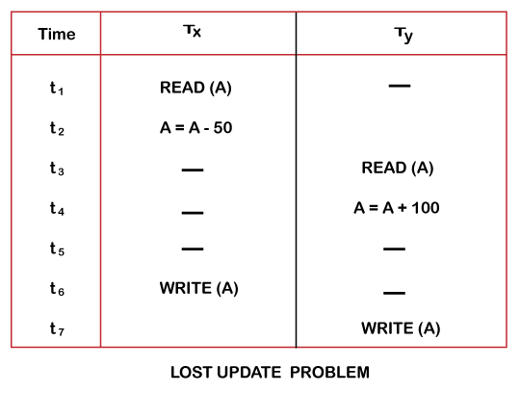
6.5.1 Concurrent Execution
Problems with Concurrent Execution
1. Lost Update Problems (W - W Conflict)
For example:
Consider the below diagram where two transactions TX and TY, are performed on the same account A where the balance of account A is $300.

Slide 72
6.5.1 Concurrent Execution
Problems with Concurrent Execution
1. Lost Update Problems (W - W Conflict)
At time t1, transaction TX reads the value of account A, i.e., $300 (only read).
At time t2, transaction TX deducts $50 from account A that becomes $250 (only deducted and not updated/write).
Alternately, at time t3, transaction TY reads the value of account A that will be $300 only because TX didn't update the value yet.
At time t4, transaction TY adds $60 to account A that becomes $400 (only added but not updated/write).
At time t6, transaction TX writes the value of account A that will be updated as $250 only, as TY didn't update the value yet.
Similarly, at time t7, transaction TY writes the values of account A, so it will write as done at time t4 that will be $400. It means the value written by TX is lost, i.e., $250 is lost.
Hence data becomes incorrect, and database sets to inconsistent.

Slide 73
6.5.1 Concurrent Execution
Problems with Concurrent Execution
2. Dirty Read Problems (W-R Conflict)
The dirty read problem occurs when one transaction updates an item of the database, and somehow the transaction fails, and before the data gets rollback, the updated database item is accessed by another transaction. There comes the Read-Write Conflict between both transactions.

Slide 74
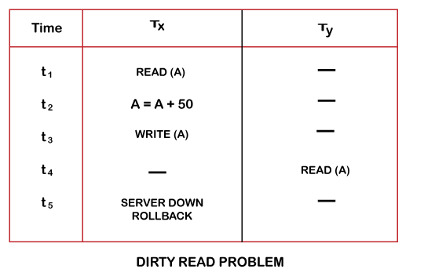
6.5.1 Concurrent Execution
Problems with Concurrent Execution
2. Dirty Read Problems (W-R Conflict)
For example:
Consider the below diagram where two transactions TX and TY, are performed on the same account A where the balance of account A is $300.

Slide 75
6.5.1 Concurrent Execution
Problems with Concurrent Execution
2. Dirty Read Problems (W-R Conflict)
At time t1, transaction TX reads the value of account A, i.e., $300.
At time t2, transaction TX adds $50 to account A that becomes $350.
At time t3, transaction TX writes the updated value in account A, i.e., $350.
Then at time t4, transaction TY reads account A that will be read as $350.
Then at time t5, transaction TX rollbacks due to server problem, and the value changes back to $300 (as initially).
But the value for account A remains $350 for transaction TY as committed, which is the dirty read and therefore known as the Dirty Read Problem.

Slide 76
6.5.1 Concurrent Execution
Problems with Concurrent Execution
3. Unrepeatable Read Problem (W-R Conflict)
Also known as Inconsistent Retrievals Problem that occurs when in a transaction, two different values are read for the same database item.

Slide 77
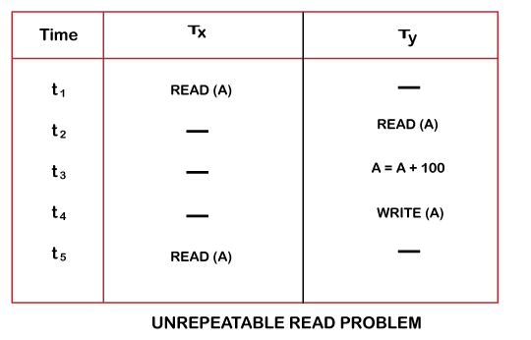
6.5.1 Concurrent Execution
Problems with Concurrent Execution
3. Unrepeatable Read Problem (W-R Conflict)
For example:
Consider the below diagram where two transactions TX and TY, are performed on the same account A where the balance of account A is $300.

Slide 78
6.5.1 Concurrent Execution
Problems with Concurrent Execution
3. Unrepeatable Read Problem (W-R Conflict)
At time t1, transaction TX reads the value from account A, i.e., $300.
At time t2, transaction TY reads the value from account A, i.e., $300.
At time t3, transaction TY updates the value of account A by adding $60 to the available balance, and then it becomes $400.
At time t4, transaction TY writes the updated value, i.e., $400.
After that, at time t5, transaction TX reads the available value of account A, and that will be read as $400.
It means that within the same transaction TX, it reads two different values of account A, i.e., $ 300 initially, and after updation made by transaction TY, it reads $400. It is an unrepeatable read and is therefore known as the Unrepeatable read problem.

Slide 79
6.5.1 Concurrency Control Protocol
The concurrency control protocols ensure the atomicity, consistency, isolation, durability and serializability of the concurrent execution of the database transactions.
Therefore, these protocols are categorized as:
Lock Based Concurrency Control Protocol
Graph Based Protocol
Time Stamp based Protocol
Multiple Granularity Control Protocol

Slide 80
6.5.1 Concurrency Control Protocol
1. Lock Based Concurrency Control Protocol
In this type of protocol, any transaction cannot read or write data until it acquires an appropriate lock on it. There are two types of lock:
a. Shared lock:
b. Exclusive lock:

Slide 81
6.5.1 Concurrency Control Protocol
1. Lock Based Concurrency Control Protocol
a. Shared lock:
It is also known as a Read-only lock. In a shared lock, the data item can only read by the transaction.
It can be shared between the transactions because when the transaction holds a lock, then it can't update the data on the data item.

Slide 82
6.5.1 Concurrency Control Protocol
1. Lock Based Concurrency Control Protocol
b. Exclusive lock:
In the exclusive lock, the data item can be both reads as well as written by the transaction.
This lock is exclusive, and in this lock, multiple transactions do not modify the same data simultaneously.

Slide 83
6.5.1 Concurrency Control Protocol
1. Lock Based Concurrency Control Protocol
There are four types of lock protocols available:
a. Simplistic lock protocol:
b. Pre-claiming Lock Protocol:
c. Two-phase locking (2PL):
d. Strict Two-phase locking (Strict-2PL):

Slide 84
6.5.1 Concurrency Control Protocol
1. Lock Based Concurrency Control Protocol
a. Simplistic lock protocol:
It is the simplest way of locking the data while transaction.
Simplistic lock-based protocols allow all the transactions to get the lock on the data before insert or delete or update on it.
It will unlock the data item after completing the transaction.

Slide 85
6.5.1 Concurrency Control Protocol
1. Lock Based Concurrency Control Protocol
b. Pre-claiming Lock Protocol:
Pre-claiming Lock Protocols evaluate the transaction to list all the data items on which they need locks.
Before initiating an execution of the transaction, it requests DBMS for all the lock on all those data items.
If all the locks are granted then this protocol allows the transaction to begin. When the transaction is completed then it releases all the lock.

Slide 86
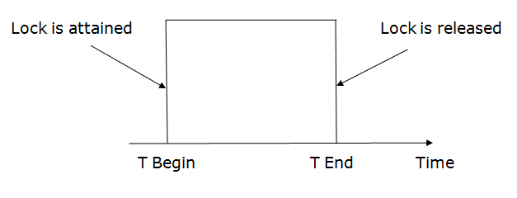
6.5.1 Concurrency Control Protocol
1. Lock Based Concurrency Control Protocol
b. Pre-claiming Lock Protocol:
If all the locks are not granted then this protocol allows the transaction to rolls back and waits until all the locks are granted.

Slide 87
6.5.1 Concurrency Control Protocol
1. Lock Based Concurrency Control Protocol
c. Two-phase locking (2PL):
The two-phase locking protocol divides the execution phase of the transaction into three parts.
In the first part, when the execution of the transaction starts, it seeks permission for the lock it requires.
In the second part, the transaction acquires all the locks. The third phase is started as soon as the transaction releases its first lock.
In the third phase, the transaction cannot demand any new locks. It only releases the acquired locks.

Slide 88
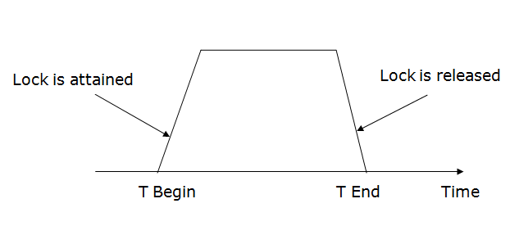
6.5.1 Concurrency Control Protocol
1. Lock Based Concurrency Control Protocol
c. Two-phase locking (2PL):

Slide 89
6.5.1 Concurrency Control Protocol
1. Lock Based Concurrency Control Protocol
c. Two-phase locking (2PL):
There are two phases of 2PL:
Growing phase: In the growing phase, a new lock on the data item may be acquired by the transaction, but none can be released.
Shrinking phase: In the shrinking phase, existing lock held by the transaction may be released, but no new locks can be acquired.

Slide 90
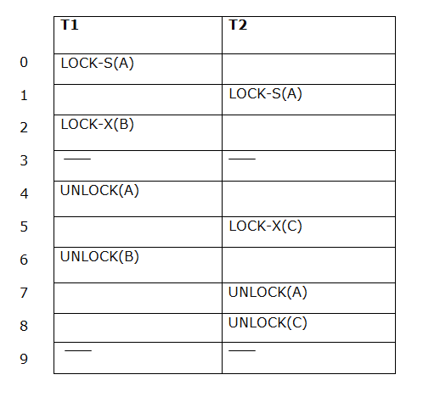
6.5.1 Concurrency Control Protocol
1. Lock Based Concurrency Control Protocol
c. Two-phase locking (2PL): Example

Slide 91
6.5.1 Concurrency Control Protocol
1. Lock Based Concurrency Control Protocol
c. Two-phase locking (2PL): Example
In the given example, if lock conversion is allowed then the following phase can happen:
Upgrading of lock (from S(a) to X (a)) is allowed in growing phase.
Downgrading of lock (from X(a) to S(a)) must be done in shrinking phase.

Slide 92
6.5.1 Concurrency Control Protocol
1. Lock Based Concurrency Control Protocol
c. Two-phase locking (2PL): Example
The following way shows how unlocking and locking work with 2-PL.
a. Transaction T1:
Growing phase: from step 1-3
Shrinking phase: from step 5-7
Lock point: at 3
b. Transaction T2:
Growing phase: from step 2-6
Shrinking phase: from step 6-9
Lock point: at 6

Slide 93
6.5.1 Concurrency Control Protocol
1. Lock Based Concurrency Control Protocol
d. Strict Two-phase locking (strict - 2PL):
The first phase of Strict-2PL is similar to 2PL. In the first phase, after acquiring all the locks, the transaction continues to execute normally.
The only difference between 2PL and strict 2PL is that Strict-2PL does not release a lock after using it.
Strict-2PL waits until the whole transaction to commit, and then it releases all the locks at a time.
Strict-2PL protocol does not have shrinking phase of lock release.

Slide 94
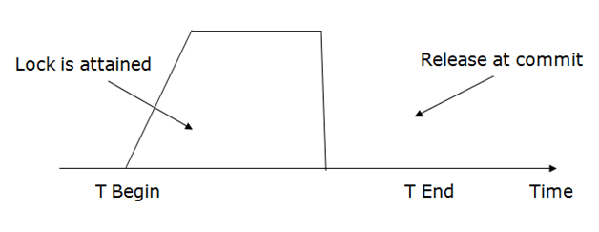
6.5.1 Concurrency Control Protocol
1. Lock Based Concurrency Control Protocol
d. Strict Two-phase locking (strict - 2PL):
It does not have cascading abort as 2PL does.

Slide 95
6.5.1 Concurrency Control Protocol
2. Graph based Protocol
Graph-based concurrency control protocols are used in database management systems (DBMS) to ensure that concurrent transactions do not interfere with each other and maintain the consistency of the database.
Transactions are represented as nodes in a graph, and the conflicts between transactions are represented as edges between the nodes.
A conflict between two transactions occurs when they access the same data item, and at least one of the transactions performs a write operation.

Slide 96
6.5.1 Concurrency Control Protocol
2. Graph based Protocol
Graph-Based Protocols are used as an alternative to 2-PL.
Tree Based Protocols is a simple implementation of Graph Based Protocol.
A prerequisite of this protocol is that we know the order to access a Database Item. For this, we implement a Partial Ordering on a set of the Database Items (D) {d1, d2, d3, ….., dn} .

Slide 97
6.5.1 Concurrency Control Protocol
2. Graph based Protocol
The protocol following the implementation of Partial Ordering is stated as-
If di –> dj then any transaction accessing both di and dj must access di before accessing dj.
Implies that the set D may now be viewed as a directed acyclic graph (DAG), called a database graph.

Slide 98
6.5.1 Concurrency Control Protocol
2. Graph based Protocol
Tree Based Protocol:
Partial Order on Database items determines a tree-like structure.
Only Exclusive Locks are allowed.
The first lock by Ti may be on any data item. Subsequently, a data Q can be locked by Ti only if the parent of Q is currently locked by Ti.
Data items can be unlocked at any time.

Slide 99
6.5.1 Concurrency Control Protocol
2. Graph based Protocol
Following the Tree based Protocol ensures Conflict Serializability and Deadlock Free schedule.
We need not wait for unlocking a Data item as we did in 2-PL protocol, thus increasing the concurrency.
Now, let us see an Example, following is a Database Graph which will be used as a reference for locking the items subsequently.

Slide 100
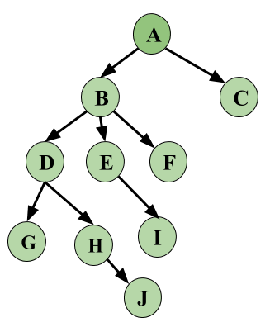
6.5.1 Concurrency Control Protocol
2. Graph based Protocol
Example, following is a Database Graph which will be used as a reference for locking the items subsequently.
Image – Database Graph

Slide 101
6.5.1 Concurrency Control Protocol
 | T₁ | T₂ | T₃
1 | Lock-X(A)
2 | Lock-X(B)
3 |  | Lock-X(D)
4 |  | Lock-X(H)
5 |  | Unlock-X(D)
6 | Lock-X(E)
7 | Lock-X(D)
6 | Unlock-X(B)
9 | Unlock-X(E)
10 |  |  | Lock-X(B)
11 |  |  | Lock-X(E)
12 |  | Unlock-X(H)
13 | Lock-X(B)
14 | Lock-X(G)
15 | Unlock-X(D)
16 |  |  | Unlock-X(E)
17 |  |  | Unlock-X(B)
16 | Unlock-X(G)
2. Graph based Protocol.
From the example, first see that the schedule is Conflict Serializable.
Serializability for Locks can be written
as T₂ –> T₁ –> T₃.

Slide 102
6.5.1 Concurrency Control Protocol
3. Time Stamp based Protocol
The Timestamp Ordering Protocol is used to order the transactions based on their Timestamps.
The order of transaction is nothing but the ascending order of the transaction creation.
The priority of the older transaction is higher that's why it executes first.
To determine the timestamp of the transaction, this protocol uses system time or logical counter.
The lock-based protocol is used to manage the order between conflicting pairs among transactions at the execution time.
But Timestamp based protocols start working as soon as a transaction is created.

Slide 103
6.5.1 Concurrency Control Protocol
3. Time Stamp based Protocol
Example:
Suppose there are there transactions T1, T2, and T3.
T1 has entered the system at time 006
T2 has entered the system at 0020
T3 has entered the system at 0030
Priority will be given to transaction T1, then transaction T2 and lastly Transaction T3.

Slide 104
6.5.1 Concurrency Control Protocol
3. Time Stamp based Protocol
The timestamp of transaction Ti is denoted as TS(Ti).
Read time-stamp of data-item X is denoted by R-timestamp(X). , is largest timestamp of any transaction that executed Read(X) successfully.
Write time-stamp of data-item X is denoted by W-timestamp(X). , is largest timestamp of any transaction that executed write(X) successfully.

Slide 105
6.5.1 Concurrency Control Protocol
3. Time Stamp based Protocol
Basic Timestamp ordering protocol works as follows:
1. Check the following condition whenever a transaction Ti issues a Read (X) operation:
If W_TS(X) >TS(Ti) then the operation is rejected.
If W_TS(X) <= TS(Ti) then the operation is executed.
Timestamps of all the data items are updated.

Slide 106
6.5.1 Concurrency Control Protocol
3. Time Stamp based Protocol
Basic Timestamp ordering protocol works as follows:
2. Check the following condition whenever a transaction Ti issues a Write(X) operation:
If TS(Ti) < R_TS(X) then the operation is rejected.
If TS(Ti) < W_TS(X) then the operation is rejected and Ti is rolled back otherwise the operation is executed.

Slide 107
6.5.1 Concurrency Control Protocol
4. Multiple Granularity Control Protocol
Granularity: It is the size of data item allowed to lock.
Multiple Granularity:
It can be defined as hierarchically breaking up the database into blocks which can be locked.
The Multiple Granularity protocol enhances concurrency and reduces lock overhead.
It maintains the track of what to lock and how to lock.
It makes easy to decide either to lock a data item or to unlock a data item.
This type of hierarchy can be graphically represented as a tree.

Slide 108
6.5.1 Concurrency Control Protocol
4. Multiple Granularity Control Protocol
For example: Consider a tree which has four levels of nodes.
The first level or higher level shows the entire database.
The second level represents a node of type area. The higher level database consists of exactly these areas.
The area consists of children nodes which are known as files. No file can be present in more than one area.
Finally, each file contains child nodes known as records. The file has exactly those records that are its child nodes. No records represent in more than one file.
Hence, the levels of the tree starting from the top level are as follows:
Database
Area
File
Record

Slide 109
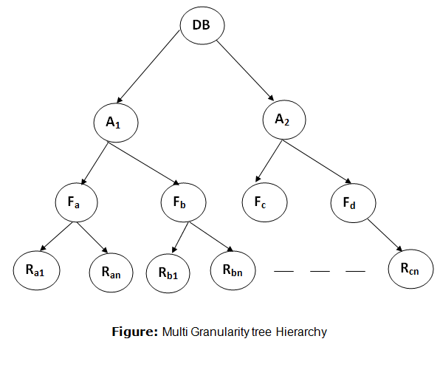
6.5.1 Concurrency Control Protocol
4. Multiple Granularity Control Protocol
For example: Consider a tree which has four levels of nodes.

Slide 110
6.6 SQL Standard Isolation Levels
It means that a transaction should take place in a system in such a way that it is the only transaction that is accessing the resources in a database system.
Isolation levels define the degree to which a transaction must be isolated from the data modifications made by any other transaction in the database system.

Slide 111
6.6 SQL Standard Isolation Levels
A transaction isolation level is defined by the following phenomena:
Dirty Read – A Dirty read is a situation when a transaction reads data that has not yet been committed. For example, Let’s say transaction 1 updates a row and leaves it uncommitted, meanwhile, Transaction 2 reads the updated row. If transaction 1 rolls back the change, transaction 2 will have read data that is considered never to have existed.

Slide 112
6.6 SQL Standard Isolation Levels
A transaction isolation level is defined by the following phenomena:
Non Repeatable read – Non Repeatable read occurs when a transaction reads the same row twice and gets a different value each time. For example, suppose transaction T1 reads data. Due to concurrency, another transaction T2 updates the same data and commit, Now if transaction T1 rereads the same data, it will retrieve a different value.

Slide 113
6.6 SQL Standard Isolation Levels
A transaction isolation level is defined by the following phenomena:
Phantom Read – Phantom Read occurs when two same queries are executed, but the rows retrieved by the two, are different. For example, suppose transaction T1 retrieves a set of rows that satisfy some search criteria. Now, Transaction T2 generates some new rows that match the search criteria for transaction T1. If transaction T1 re-executes the statement that reads the rows, it gets a different set of rows this time.

Slide 114
6.6 SQL Standard Isolation Levels
Based on these phenomena, The SQL standard defines Five isolation levels:
Read Uncommitted
Read Committed
Repeatable Read
Serializable
Snapshot.

Slide 115
6.6 SQL Standard Isolation Levels
1. Read Uncommitted
Transactions are not required to lock rows before reading or writing data. This means that a transaction can read data that has been modified by another uncommitted transaction.
This can lead to non-repeatable reads and phantom reads. However, it provides the highest level of concurrency and can be useful in certain situations.

Slide 116
6.6 SQL Standard Isolation Levels
1. Read Uncommitted
Example: Transaction A is updating a row in Table X, and Transaction B reads the same row before Transaction A commits the change. Transaction B can see the uncommitted data from Transaction A.
Locking behavior: No lock at all. Transactions can read uncommitted data from other transactions.

Slide 117
6.6 SQL Standard Isolation Levels
2. Read Committed
Transactions must wait for a row to be committed before reading it. This ensures that transactions do not read data that is in the process of being changed by another transaction.
However, this can still result in non-repeatable reads and phantom reads.

Slide 118
6.6 SQL Standard Isolation Levels
2. Read Committed
Example: Transaction A updates a row in Table X, and Transaction B attempts to read the same row before Transaction A commits the change. Transaction B must wait for the row to be committed before reading it.
Locking behavior: Simple lock. Transactions can only read committed data from other transactions.

Slide 119
6.6 SQL Standard Isolation Levels
3. Repeatable Read
Transactions must acquire locks on all rows that they read or write. This ensures that other transactions cannot modify or delete the rows while the transaction is in progress.
However, this can still result in phantom reads.

Slide 120
6.6 SQL Standard Isolation Levels
3. Repeatable Read
Example: Transaction A selects all rows from Table X, and Transaction B updates one of the rows in Table X. Transaction B must wait for Transaction A to release its lock on the entire table before making the update.
Locking behavior: Rows-level lock. Transactions acquire locks on all rows they read or write.

Slide 121
6.6 SQL Standard Isolation Levels
4. Serializable
Transactions must acquire locks on entire tables before reading or writing data. This ensures that other transactions cannot modify or delete any data in the table while the transaction is in progress.
However, this can lead to a high level of contention and can impact performance.

Slide 122
6.6 SQL Standard Isolation Levels
4. Serializable
Example: Transaction A selects all rows from Table X, and Transaction B attempts to insert a new row into Table X. Transaction B must wait for Transaction A to release its lock on the entire table before making the insert.
Locking behavior: Table-level lock. Transactions acquire locks on entire tables.

Slide 123
6.6 SQL Standard Isolation Levels
5. Snapshot
Each transaction has its own snapshot of the database. This means that a transaction can read data without acquiring locks, and other transactions can modify data without impacting the current transaction.
This provides the highest level of consistency and accuracy but can impact performance due to the need to maintain multiple snapshots.

Slide 124
6.6 SQL Standard Isolation Levels
5. Snapshot
Example: Transaction A selects all rows from Table X, and Transaction B inserts a new row into Table X. Both transactions see different snapshots of the table and can operate independently.
Locking behavior: No lock at all. Each transaction operates on its own snapshot of the database.

Slide 125
6.6 SQL Standard Isolation Levels
Summary of locking behavior
Read Uncommitted: No lock at all
Read Committed: Simple lock
Repeatable Read: Rows-level lock
Serializable: Table-level lock
Snapshot: No lock at all (each transaction operates on its own snapshot)

Slide 126
Assignment
Visit the given link and study and write your view on the following topics:
Deadlock in dbms
https://www.geeksforgeeks.org/deadlock-in-dbms/
Starvation in dbms
https://www.geeksforgeeks.org/starvation-in-dbms/

Slide 127
This is the end of the lecture!
I hope you enjoyed it.
Thank You

